Slide 1
Bismillaahir Rahmaanir Raheem
As Salaamu Alaikum wa Rehmatullaahi wa Barakaatuhu

Slide 2
Chennai Shia Youth
Presents
‘Learn Arabic Alphabets’
in Powerpoint Presentation

Slide 4
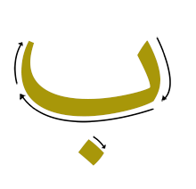

Slide 23
ق

Slide 30
لا

Slide 31
ء

Slide 33
Thank You
Visit Again
Http://Www.ChennaiShiaYouth.Com/

